Slide 1
Bioinformatics Tutorial Lecture 2
Michael Jochum, PhD Postdoctoral Research Associate Department of Obstetrics & Gynecology Baylor College of Medicine 1 Baylor Plaza, Houston TX 77401 email michael.jochum@bcm.edu

Slide 2
Objectives
Variables and For loops
Help installing tools / An introduction to Conda
Accessing data from NCBI at the command line
Version control (github)
Marker Gene Sequencing overview
Background of sequencing technology
Intro to FASTA/FASTQ file formats
Compression formats and tools (zip, gzip, pbzip, bzip2, pigz)
Demultiplexing example (Sabre / QIIME demux)
Trimming / QA/QC (Trimmomatic, cutadapt, FASTQC/MultiQC)

Slide 3
Variables and For loops
Variables $variable vs variable
Quotations (single and double)
For loops
Looping through lines of a file
Magic word | Purpose
for | set the loop variable name
in | specify whatever it is we are looping over
do | specify what we want to do with each item
done | tell the computer we are done telling it what to do with each item
for item in car truck ukulele
do
echo $item
done
for item in $(words.txt)
do
echo $item
done

Slide 4

What is Conda and why do we love it?
Getting and installing conda:
curl -LO https://repo.anaconda.com/miniconda/Miniconda3-latest-Linux-x86_64.sh
bash Miniconda3-latest-Linux-x86_64.sh
hit the space bar.
Type yes.
source ~/.bashrc
Environments
Finding and installing packages
A note on Channels
An example of something we might want to install in our base environment

Slide 5
Here is an example of something we might want to install in our base environment:
conda activate base
conda install -y -c conda-forge -c bioconda -c defaults -c astrobiomike bit
bit-summarize-assembly random-assembly.fa
Other Conda Resources
Main Conda documentation
Main Conda user guide
Getting started tutorial from Conda folks
Conda cheat sheet
Anaconda.org (A good place to search for packages if a regular web-search is failing us)

Slide 6
Accessing data from NCBI at the command line
NCBI is awesome, but it can be difficult to access.
ncbi-genome-download and ncbi-acc-download are useful tools for searching by taxonomy and downloading genomes (assemblies).
EDirect is a set of tools NCBI provides to enable accessing the vast amount of information stored at NCBI from the command line.
conda install -y -c conda-forge -c bioconda -c defaults entrez-direct

Slide 7

Version control (github)
Version control helps developers track and manage changes to a software project’s code.
How To Get Started With GitHub
To get started with GitHub:
Sign up for a free GitHub account
Follow the GitHub Hello World guide to understand the most popular actions you’ll likely want to take

Slide 8

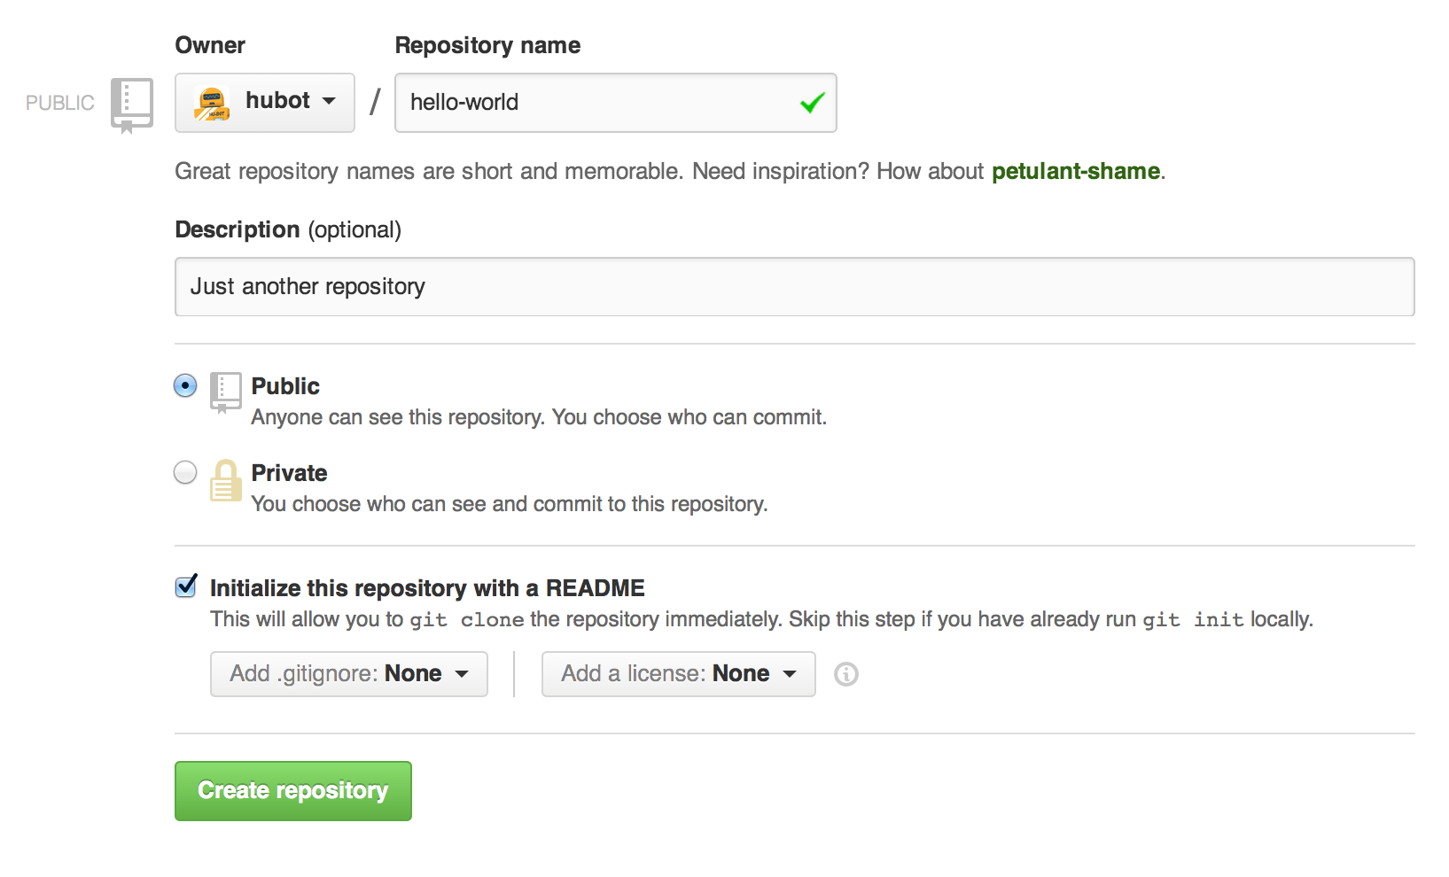
1. Create a new repository
In the upper right corner, next to your avatar or identicon, click and then select New repository.
Name your repository hello-world.
Write a short description.
Select Initialize this repository with a README.

Slide 9
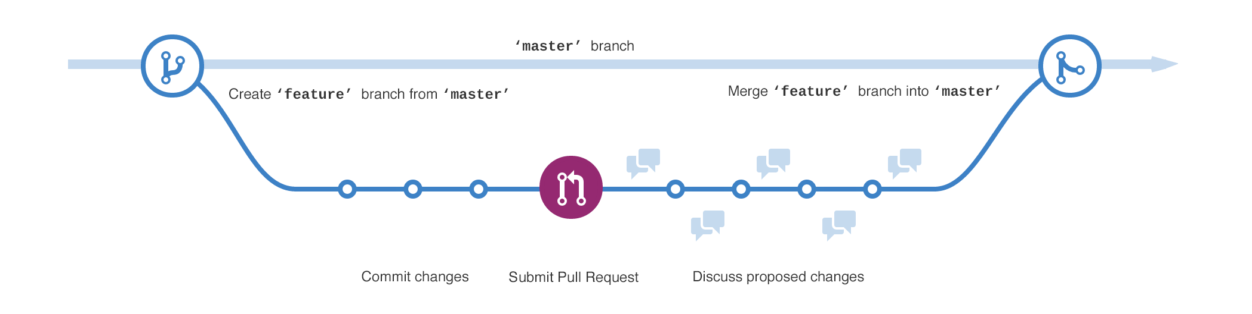
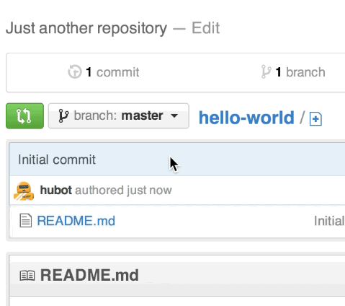
2. Create a Branch
Go to your new repository hello-world.
Click the drop down at the top of the file list that says branch: master.
Type a branch name, readme-edits, into the new branch text box.
Select the blue Create branch box or hit “Enter” on your keyboard.

Slide 10
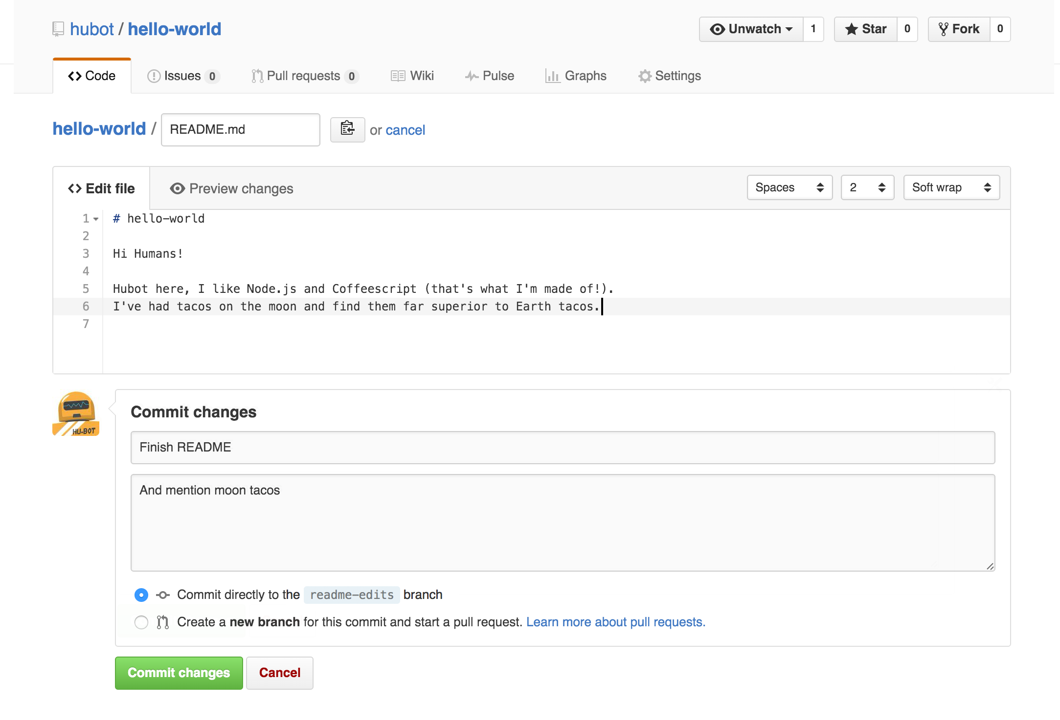
3. Make and commit changes
Make and commit changes
Click the README.md file.
Click the pencil icon in the upper right corner of the file view to edit.
In the editor, write a bit about yourself.
Write a commit message that describes your changes.
Click Commit changes button.

Slide 11
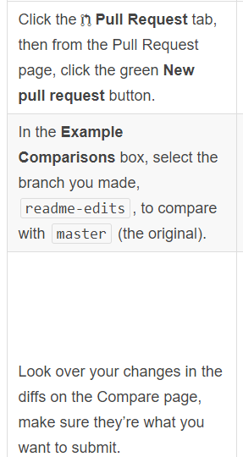
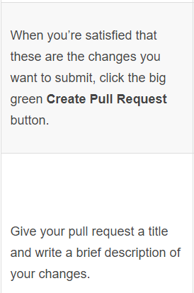
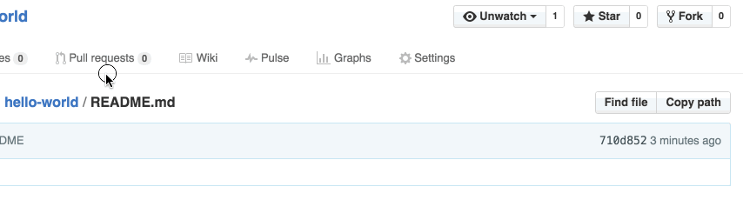
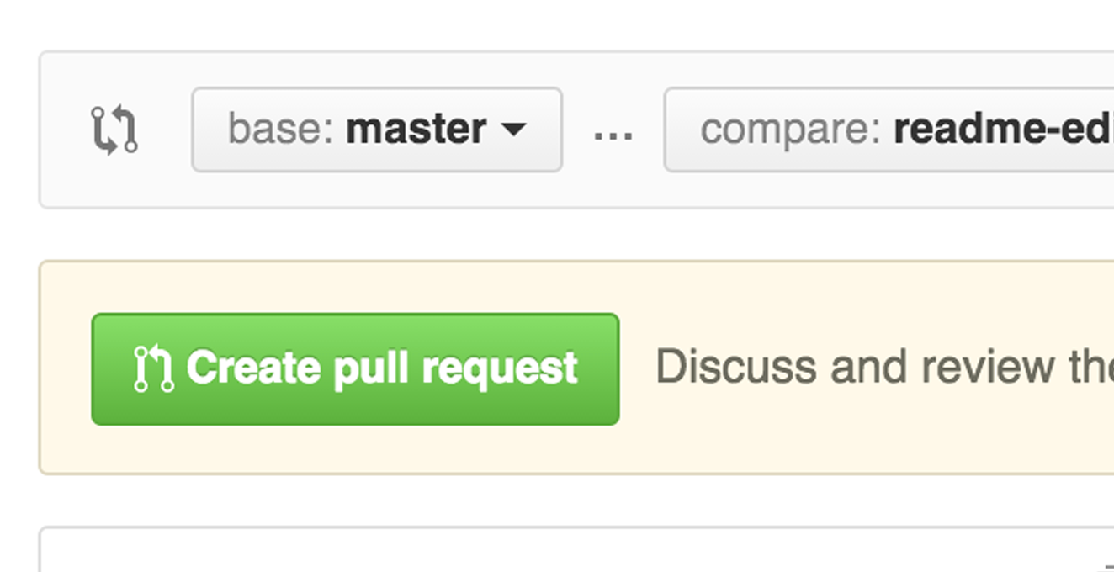
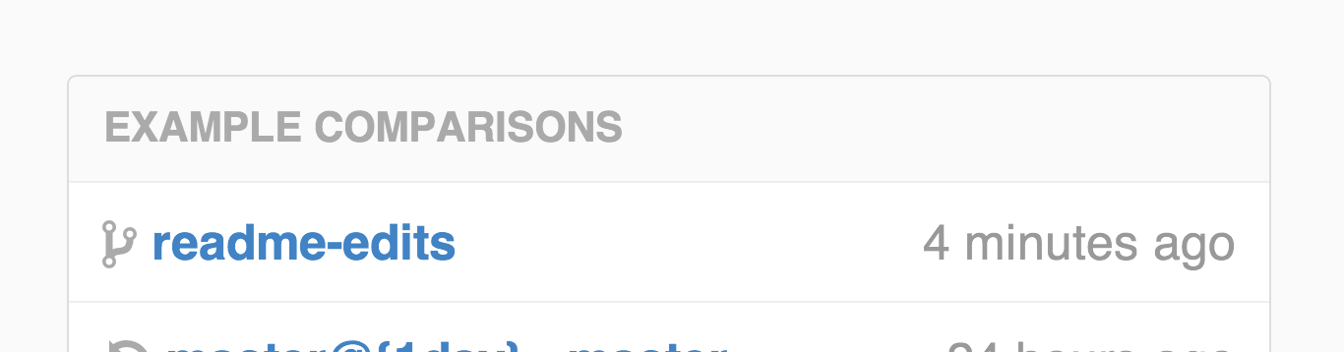
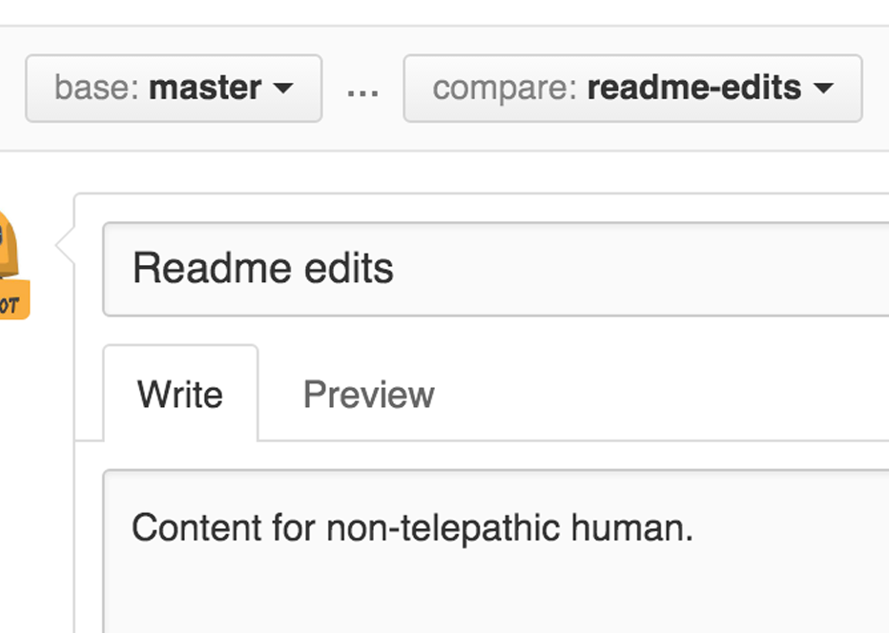
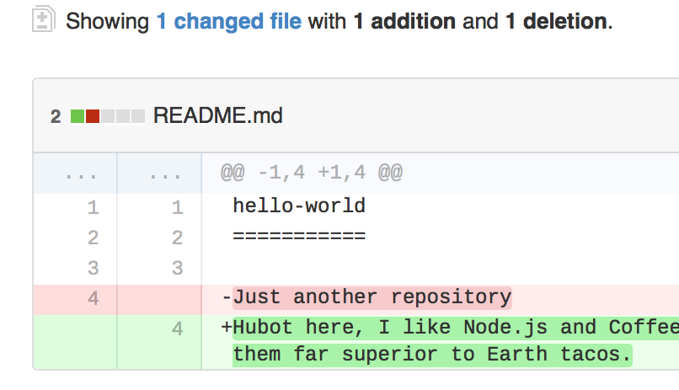
Step 4. Open a Pull Request

Slide 12

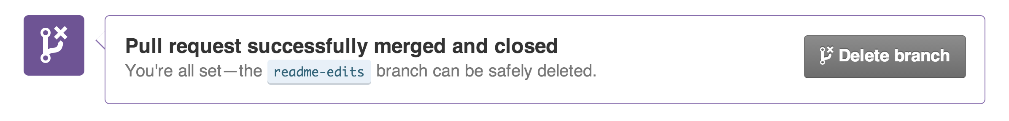
Step 4. Merge the Pull Request
Click the green Merge pull request button to merge the changes into master.
Click Confirm merge.
Go ahead and delete the branch, since its changes have been incorporated, with the Delete branch button in the purple box.
Celebrate!

Slide 13
Adding a new SSH key to your GitHub account
https://help.github.com/en/enterprise/2.15/user/articles/adding-a-new-ssh-key-to-your-github-account

Slide 14

Introduction to Sequencing by Synthesis
Watch this video

Slide 15
FASTQ Files
A FASTQ file normally uses four lines per sequence.
Line 1 begins with a '@' character and is followed by a sequence identifier and an optional description (like a FASTA title line).
Line 2 is the raw sequence letters.
Line 3 begins with a '+' character and is optionally followed by the same sequence identifier (and any description) again.
Line 4 encodes the quality values for the sequence in Line 2, and must contain the same number of symbols as letters in the sequence.
A FASTQ file containing a single sequence might look like this:
@SEQ_ID GATTTGGGGTTCAAAGCAGTATCGATCAAATAGTAAATCCATTTGTTCAACTCACAGTTT + !''*((((***+))%%%++)(%%%%).1***-+*''))**55CCF>>>>>>CCCCCCC65
The byte representing quality runs from 0x21 (lowest quality; '!' in ASCII) to 0x7e (highest quality; '~' in ASCII). Here are the quality value characters in left-to-right increasing order of quality (ASCII):
!"#$%&'()*+,./0123456789:;<=>?@ABCDEFGHIJKLMNOPQRSTUVWXYZ[\]^_`abcdefghijklmnopqrstuvwxyz{|}~

Slide 16
Compression formats and tools (zip, gzip, pbzip, bzip2, pigz)
Compression formats and tools (zip, gzip, pbzip, bzip2, pigz)
Demultiplexing example (Sabre / QIIME demux)
Trimming / QA/QC (Trimmomatic, cutadapt, FASTQC/MultiQC)

Slide 17




Compression formats and tools (zip, gzip, pbzip, bzip2, pigz)
Compression formats and tools (zip, gzip, pbzip, bzip2, pigz)

Slide 18
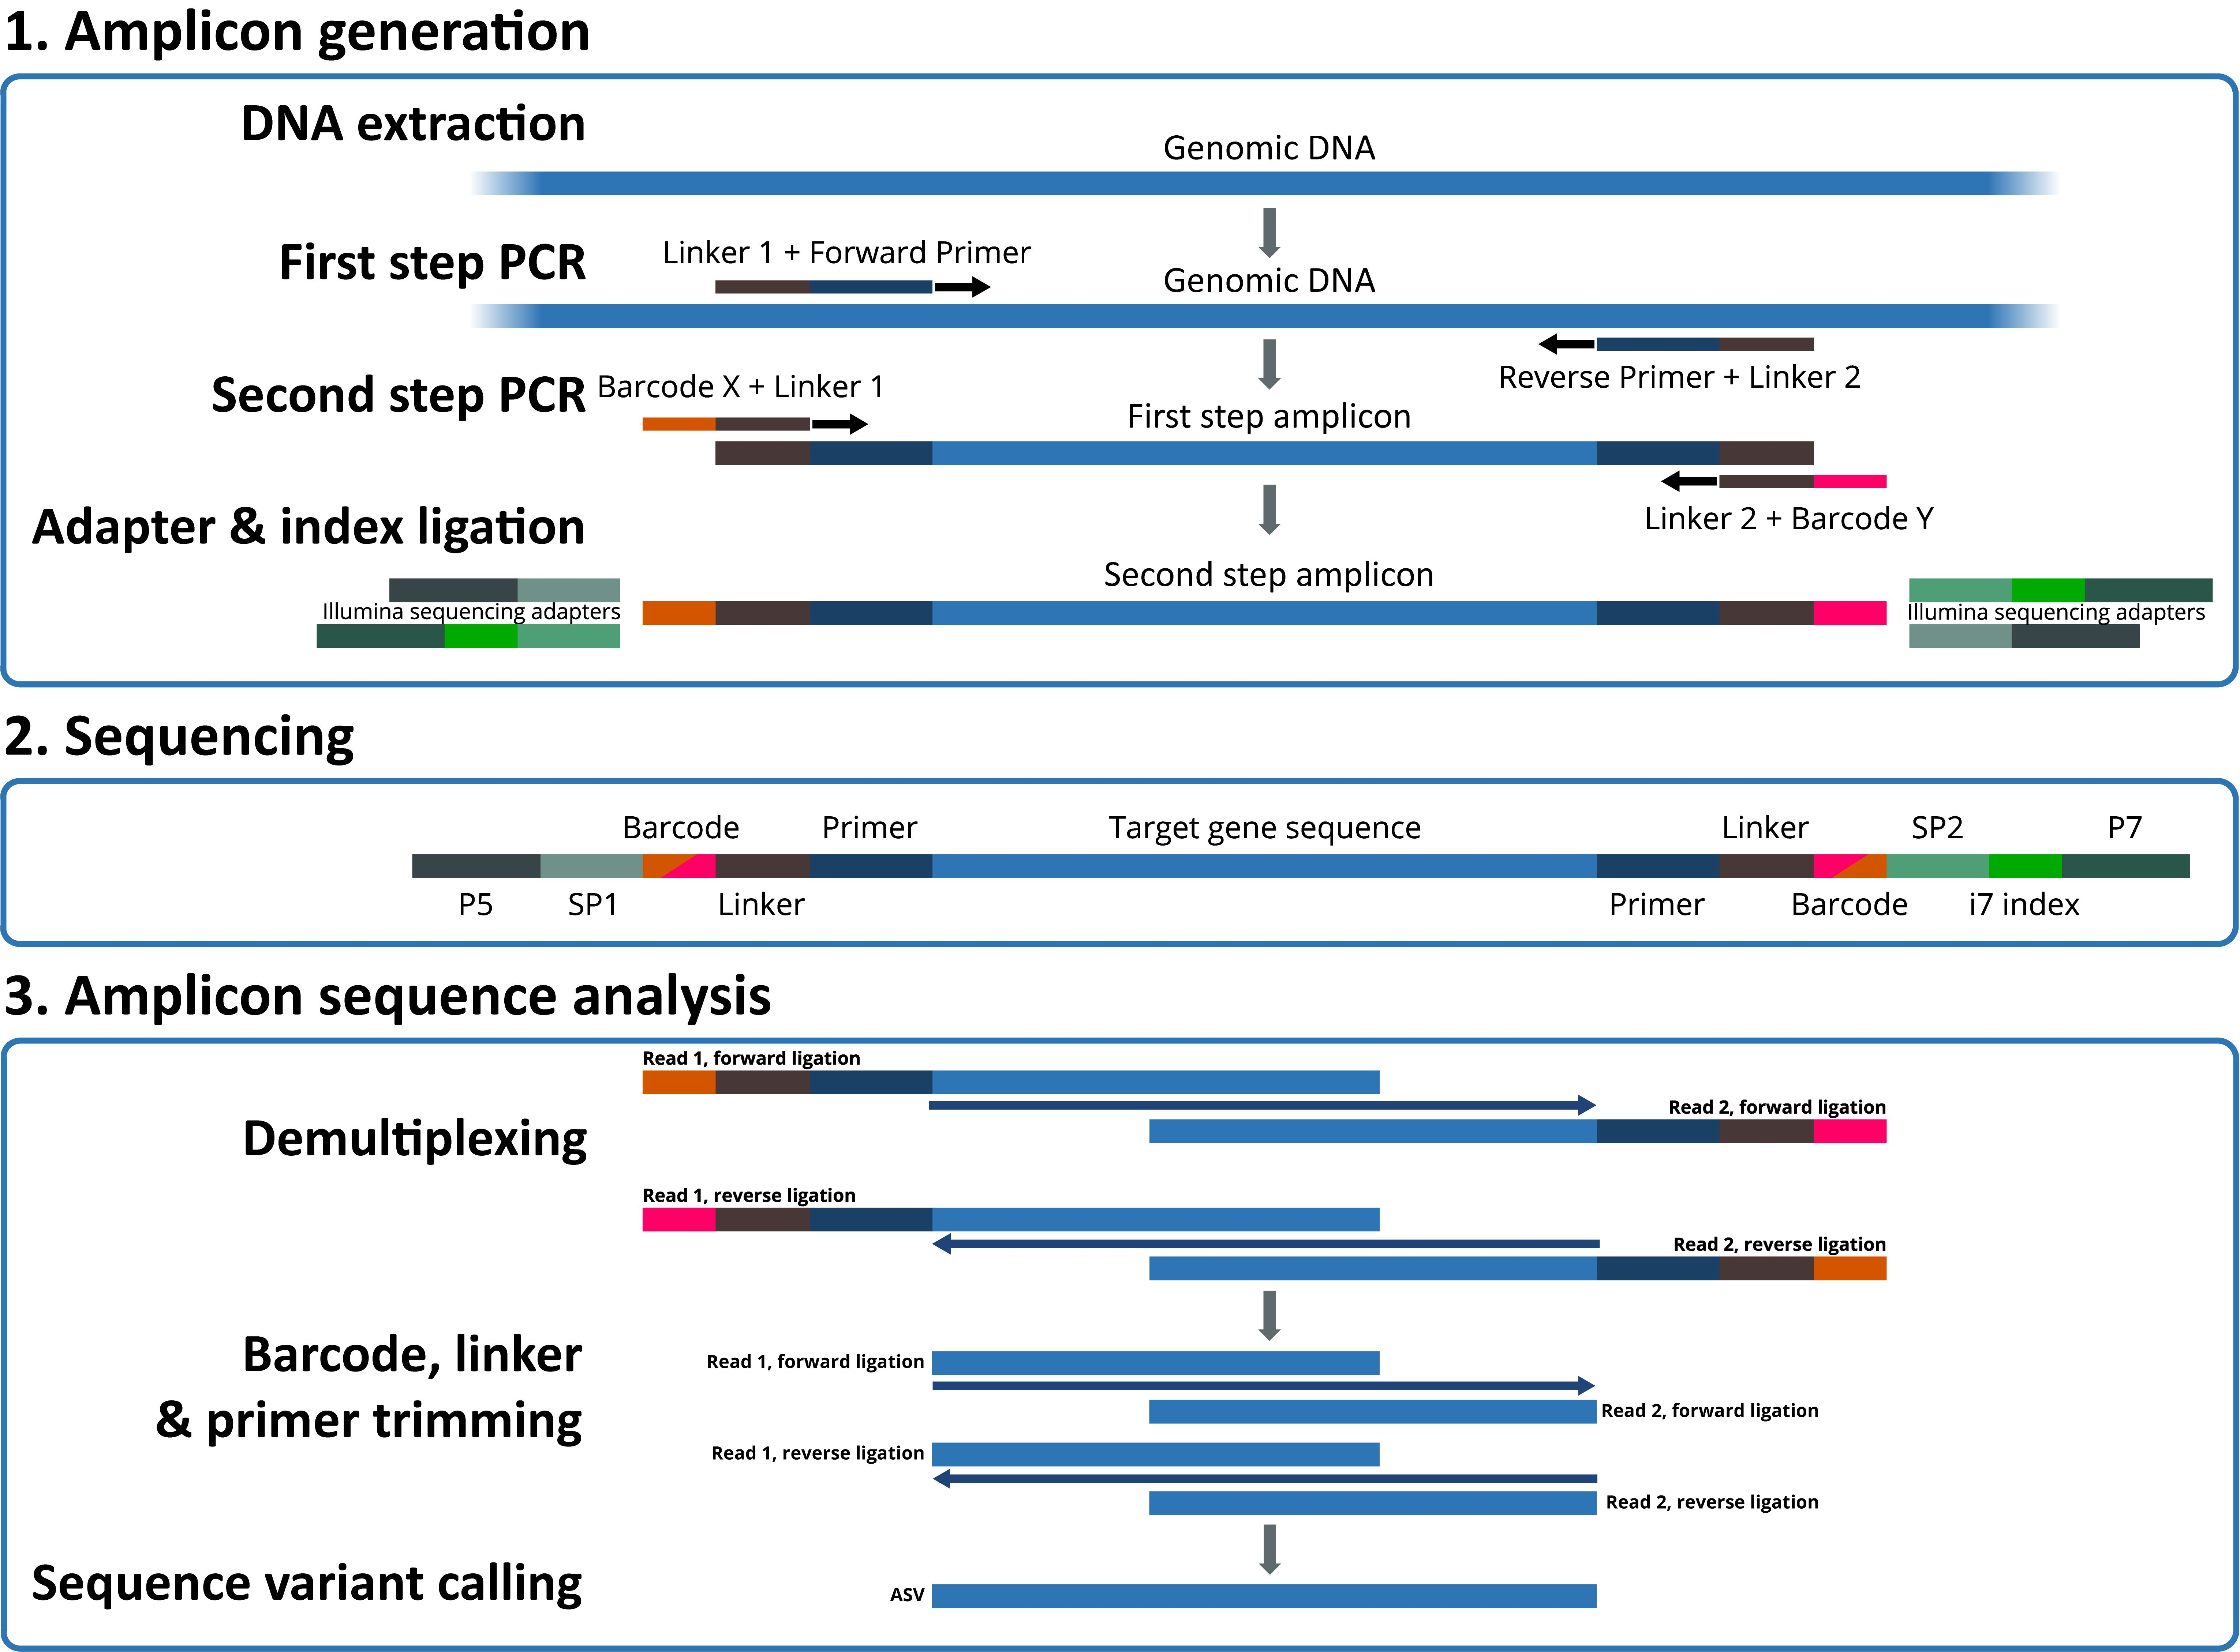
Demultiplexing, Trimming, and QA/QC
https://jmf.csb.univie.ac.at/highly-multiplexed-gene-amplicon-sequencing

Slide 19
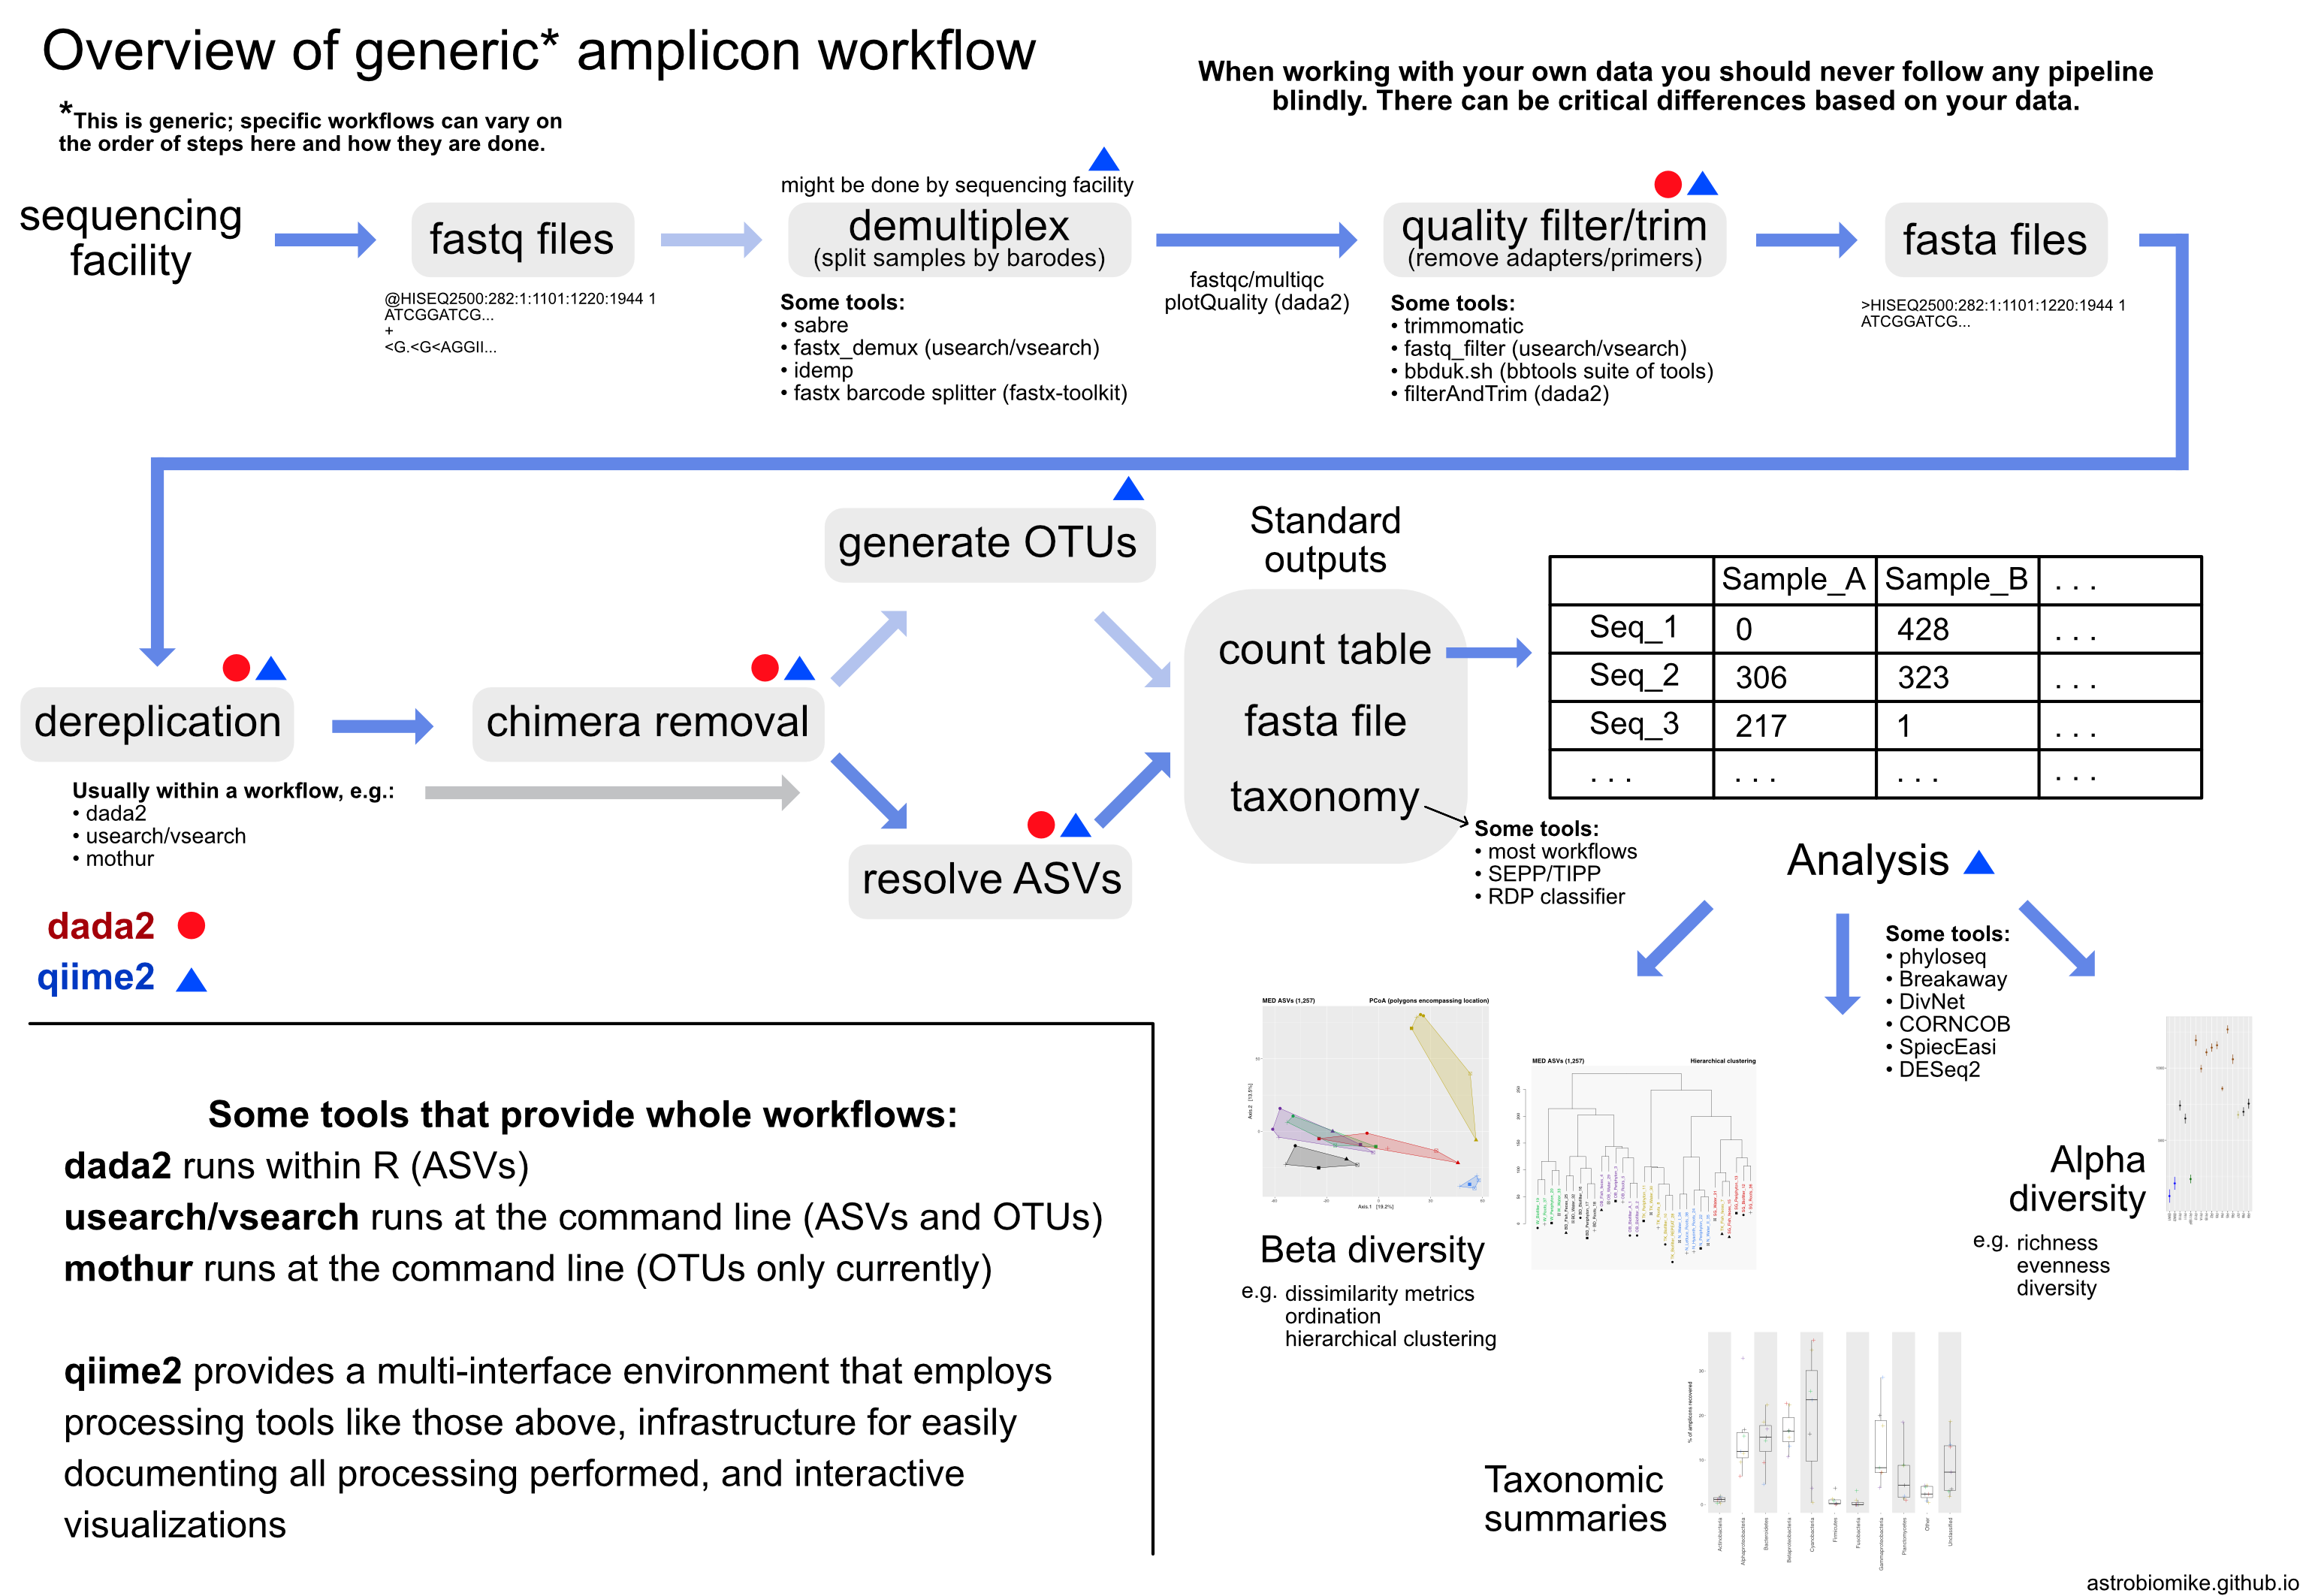
https://astrobiomike.github.io/about/

